Slide 1
TIME SERIES ANALYSIS
Pollutant Levels
IN San DIEGO
Sneha Thanasekaran
Anuj Mathur

Slide 2
DATASET
Source: data.world
Air Pollution in the U.S. since 2000-2011.
Includes four major pollutants
Nitrogen Dioxide
Sulphur Dioxide
Carbon Monoxide
and Ozone)
Our Focus is on:
City: San Diego
Mean : The arithmetic mean of concentration of NO2, O3, SO2 and O3 within a given Month of the year

Slide 3
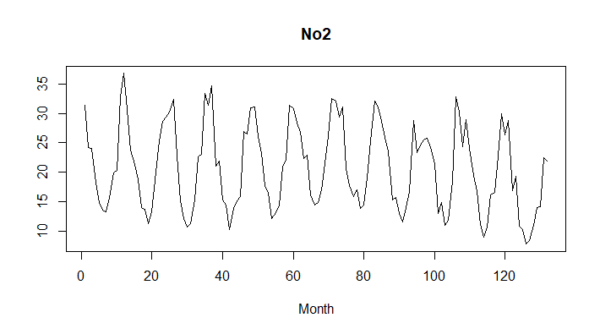
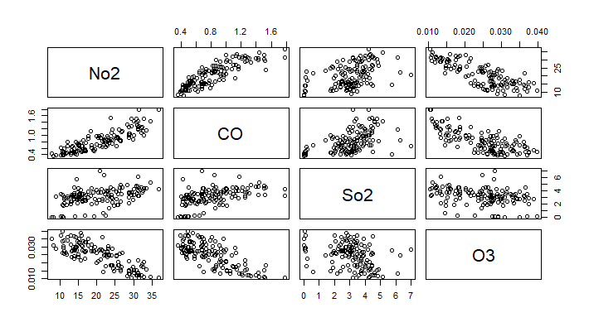
Our Models
UNIVARIATE
The arithmetic mean of concentration of NO2within a given Month of the year
MULTIVARIATE
The arithmetic mean of concentration of NO2, O3, SO2 and O3 within a given Month of the year

Slide 4
Preparing the Dataset
data <- read.csv('uspollution_pollution_us_2000_2011.csv’)
dataSD <- data[data$City == "San Diego",]
df <- data.frame(date = dataSD$Date.Local,
year = year(dataSD$Date.Local),
month = month(dataSD$Date.Local))
datadate <- cbind(df,dataSD)
testdatadate <- datadate[datadate$year == 2011,]
datadate <- datadate[datadate$year != 2011,]
unique(datadate$year)
unique(testdatadate$year)
[1] 2000 2001 2002 2003 2004 2005 2006 2007 2008 2009 2010
[1] 2011

Slide 5
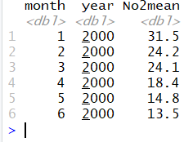
Preparing the Dataset
df_no2 <- datadate %>%
mutate(norm = mean(NO2.Mean)) %>%
group_by(month,year) %>%
dplyr::summarize(No2mean =mean(NO2.Mean)) %>%
arrange(year, month)
head(df_no2)

Slide 6
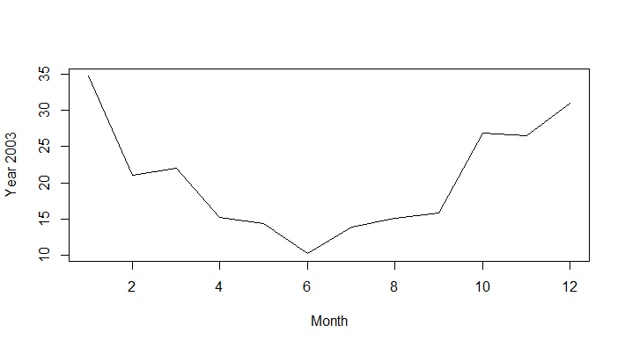
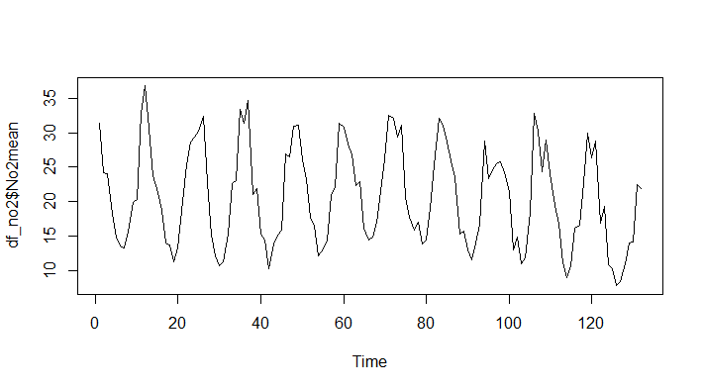
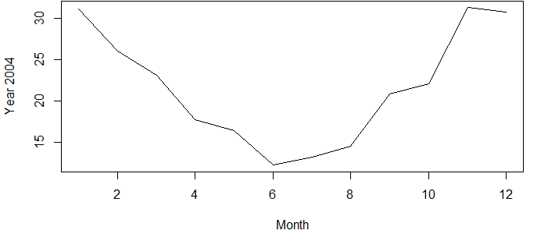
Stationarity and Seasonality
No2 Mean – Time Series Plot
Factor for pattern:
Weather
Traffic

Slide 7
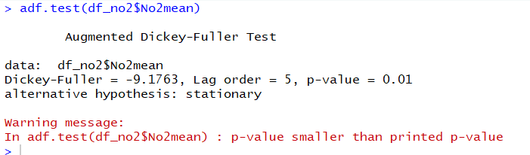
Test For Stationarity

Slide 8
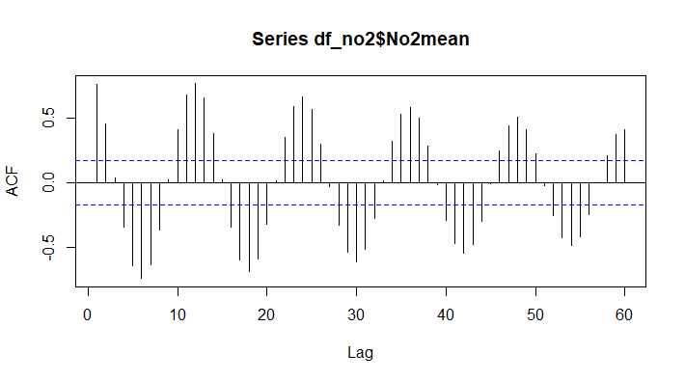
Test For Seasonality

Slide 9
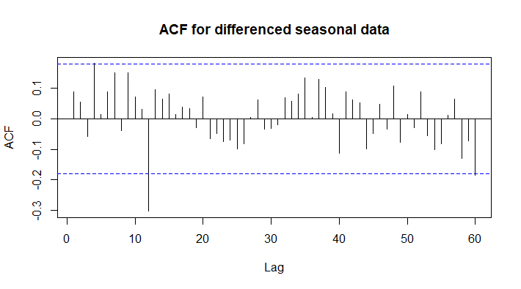
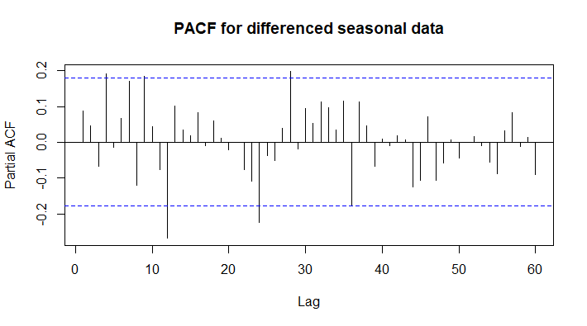
Taking Difference For Seasonality
diffseasonal = diff(df_no2$No2mean,12)
par(mfrow=c(1,2))
acf(diffseasonal,main='ACF for differenced seasonal data',lag.max=60) #MA1
pacf(diffseasonal,main='PACF for differenced seasonal data', lag.max=60) #AR3

Slide 10
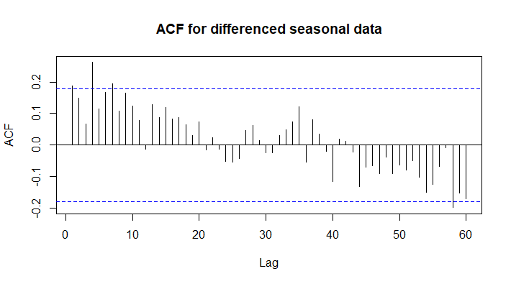
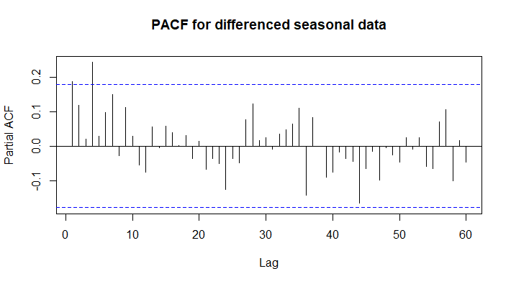
Modelling THE Seasonality
out1=arima(diffseasonal,order=c(0,0,0),seasonal=list(order=c(3,0,0),period=12))
par(mfrow=c(1,2))
acf(out1$residuals,main='ACF for differenced seasonal data',lag.max=60) #MA4
pacf(out1$residuals,main='PACF for differenced seasonal data', lag.max=60) #AR4

Slide 11
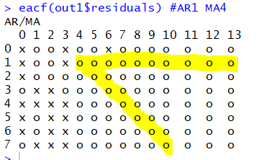
Taking Difference For Seasonality
eacf(out1$residuals) #AR1 MA4

Slide 12
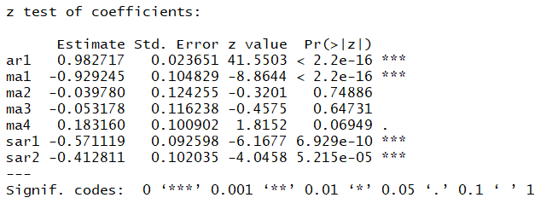
Finalizing the Model
out3.1.arma14=arima(df_no2$No2mean,order=c(1,0,4),seasonal=list(order=c(2,1,0),period=12))
out3.1.arma14
acf(out3.1.arma14$residuals,main='ACF for differenced seasonal differenced data',lag.max=60)
pacf(out3.1.arma14$residuals,main='PACF for differenced seasonal differenced data', lag.max=60)
coeftest(out3.1.arma14)

Slide 13
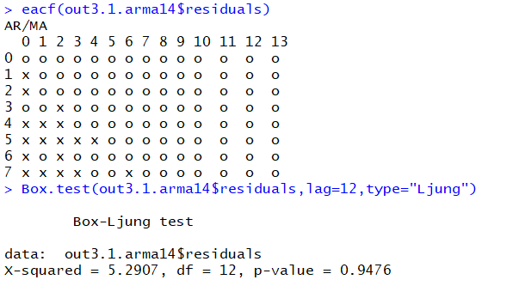
Finalizing the Model

Slide 14
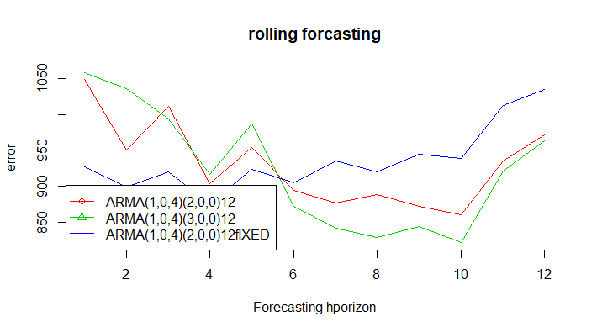
Choosing the right Model
print(c(out2.1.arma14$aic, out2.1.arma22$aic, out3.1.arma14$aic, out3.1.arma14.fixed$aic))
[1] 619.1342 621.2042 626.1821 622.5653

Slide 15
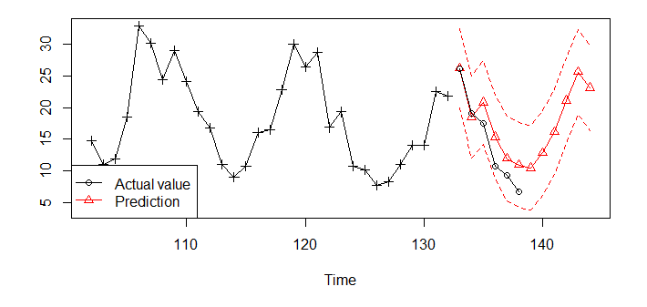
Predicting the next 12 months

Slide 16
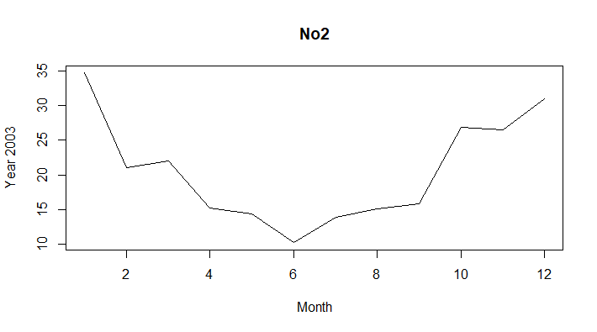
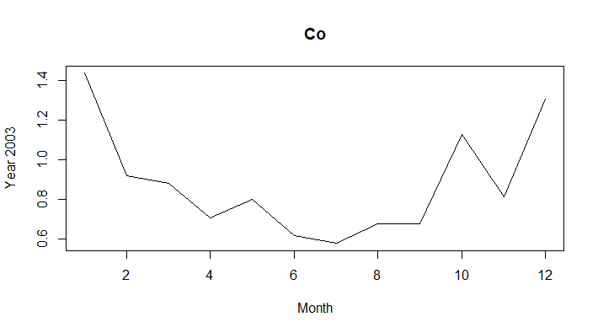
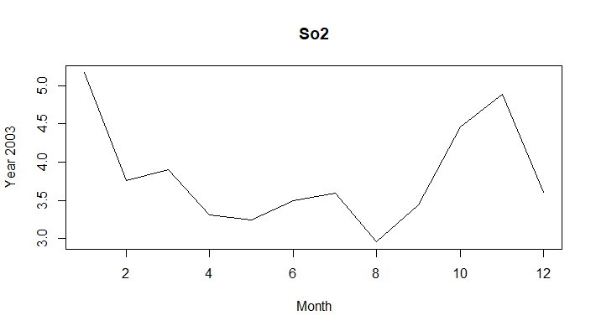
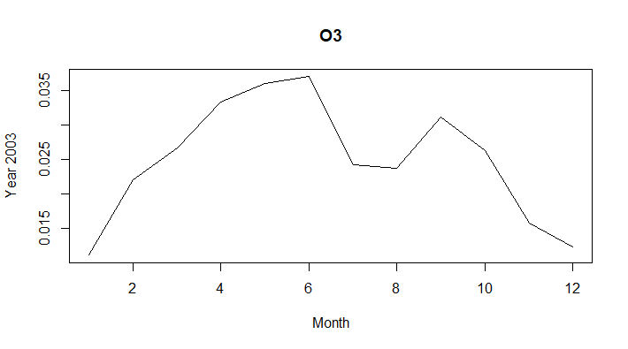
Multivariate analysis
Source: data.world
Nitrogen Dioxide
Sulphur Dioxide
Carbon Monoxide
and Ozone
From Weather reports, it is observed for CO, SO2 and NO2 with the maximum concentrations in the winter and the minimum in the summer, while O3 exhibited an opposite trend

Slide 17
Multivariate analysis

Slide 18
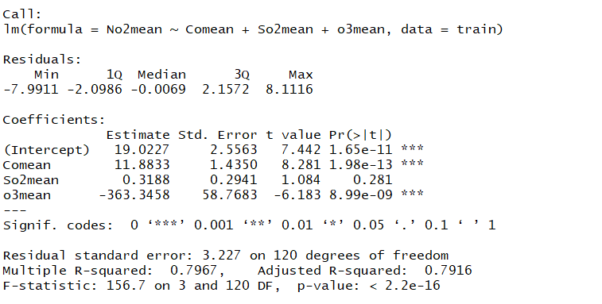
Linear Regression
data=cbind(df_no2[3], df_co[3], df_So2[3], df_o3[3])
train=as.data.frame(data[1:124,])
new.data=data[125:n,2:4]
lm=lm(No2mean~Comean + So2mean + o3mean,data=train)
summary(lm)

Slide 19
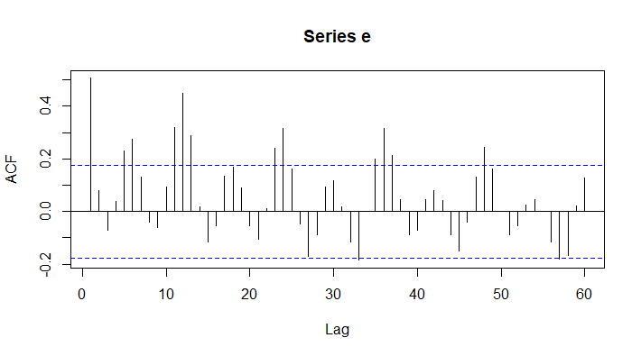
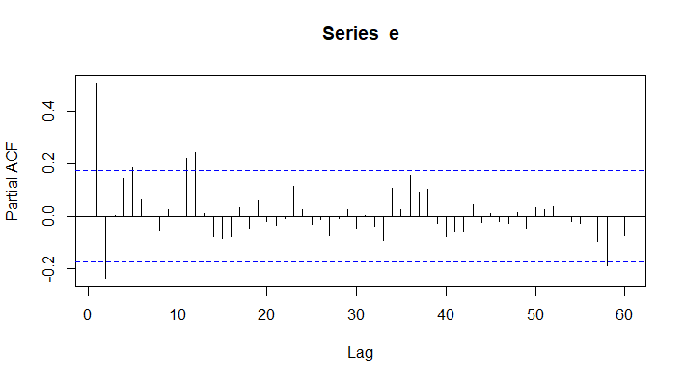
Modeling Multivariate Analysis
e=lm$residuals
plot(e,type='l’)
par(mfrow=c(1,2))
acf(e, lag.max = 60) #MA4 seasonality
pacf(e, lag.max = 60) #AR1

Slide 20
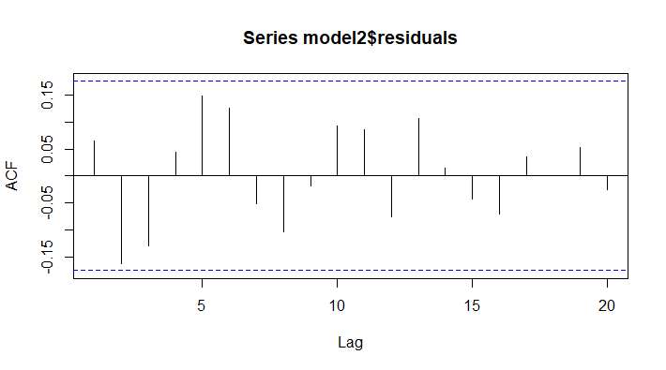
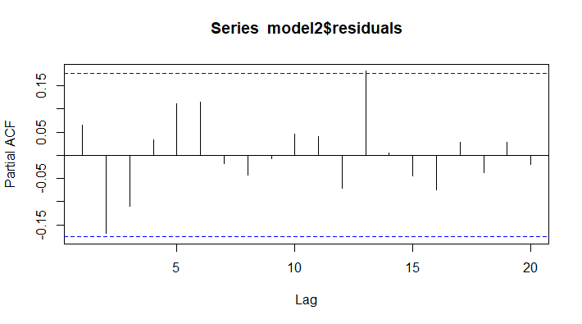
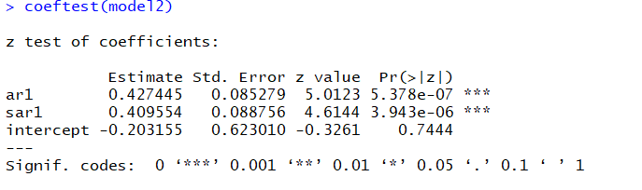
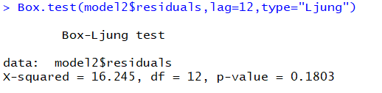
Modeling Multivariate Analysis
model1=arima(e,order=c(0,0,0),seasonal=list(order=c(1,0,0),period=12))
model2=arima(e,order=c(1,0,0),seasonal=list(order=c(1,0,0),period=12))

Slide 21
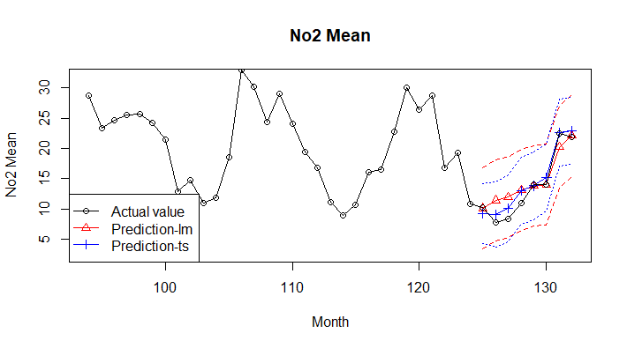
Predicting the next 12 months

Slide 22
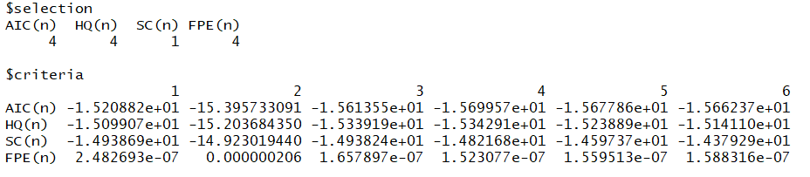
Modeling VAR MODEL
#model selection
VARselect(data[,2:4],lag.max=6)

Slide 23
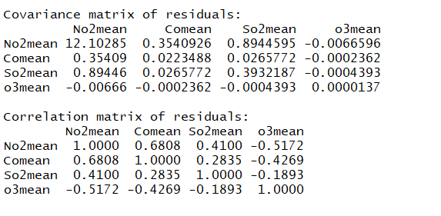
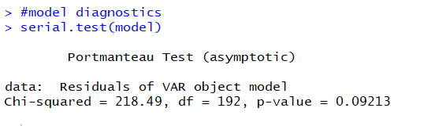
Auto Correlation
model=VAR(data,p=4)
summary(model)
#model diagnostics
serial.test(model)

Slide 24
THANK you
Any questions?

